Slide 1

Final Assessment-Excel
Shaik Sharez Hussain

Slide 2
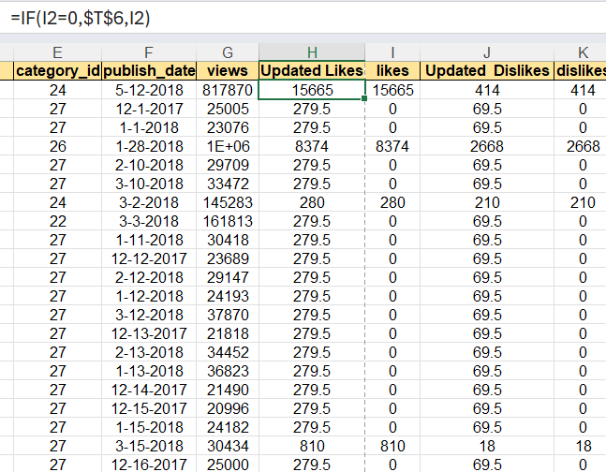
Q1
Task Given is to clean the data that is the first step is to delete the duplicate values. There are no duplicate values found in this excel sheet. The Delete Duplicate values from the data tab is used here.
Then The Next subtask is to replace the missing or null values with either mode or median. I used median here as the mode function gives only the most frequent value.. SO in median it gives the value which is exactly positioned well.
Formula Used: =IF(I2=0,$T$6,I2) Here I2 is the column with likes and T6 is the column with the median of the likes column..Its the same for dislikes also..A new updated likes column is created…Also for the dislikes column

Slide 3
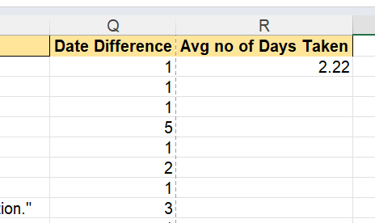
Q2
Task Given is to find the average time or the average number of days taken for a video to go on the trending list. Here in the dataset we are given two rows that is ‘Date Published’ that is the date which the video got published and ‘Trending date’ is when the video got into the trending list. I created a new column named difference between days…By calculating the no of days between the two dates using the ‘-’ subtract..
Then I found the average of the whole new column i created in the last step.
Insights:So The average time taken for a video to get into the trending section is 2 days
Formula Used :=AVERAGE(Q2:Q593)

Slide 4
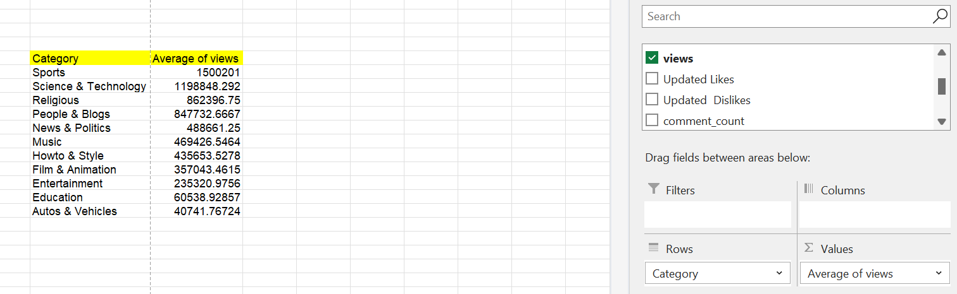
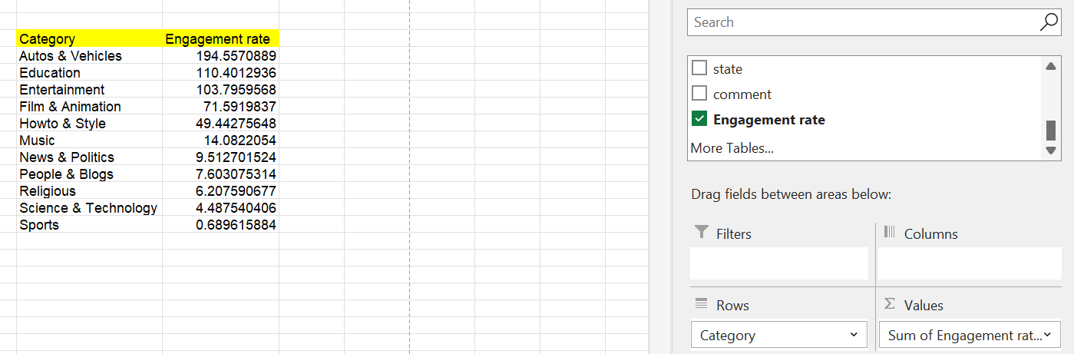
Q3
The task given is to first match the Category ID with Category Name.. I used Vlookup to match the category names with the category ID. After That a pivot table is created with category and average of views and for also the engagement rate Insights found is the SPORTS category is doing very well and it is in the first place. There are many good categories in the list..Youtube can focus on pushing content or keep effort related to education and the autos and vehicles category
Coming to the engagement part.. The Engagement rate of ‘autos’ category is high.

Slide 5
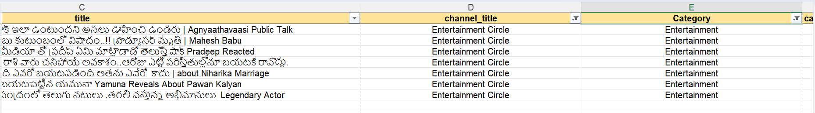
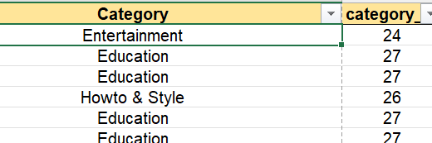
Q4
Task Given is to filter the data for a particular category and particular channel..
Here I used the filter and first filtered the category …I chose Entertainment and then the channel named ‘Entertainment Circle’
All the videos of that channel appear..
The Other sub task is to match the category with the category id..Category Names are mentioned in the other sheet..I used Xlookup..
Formula Used:=VLOOKUP(F2,Category!$A$1:$B$33,2,FALSE)
The Insight I found is about the channel..By using filter I got to know about that particular channel

Slide 6
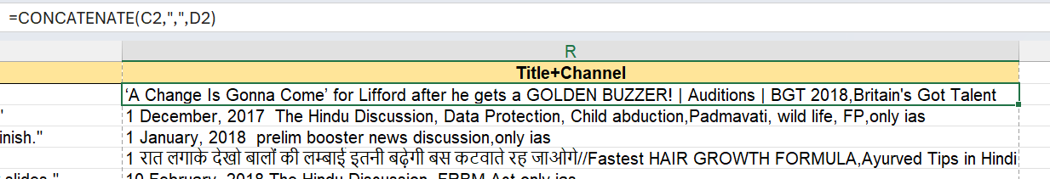
Q5
The Task is to concatenate the title of the video and the title of the channel..
The formula used is =Concatenate(C2,”,”,D2)
This will help in concatenating the values in both the cells and this wiil be useful for the sentiment analysis

Slide 7
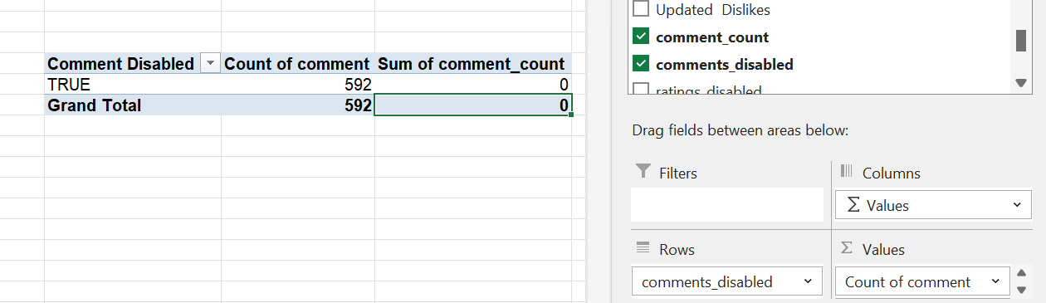
Q6
The Task is to count the average number of comments for videos with comments enabled vs comments disabled..
Since I was given a filtered data and all the data/ videos have 0 comments…So using pivot table.. I categorized the Comments disabled and the count of videos in it

Slide 8
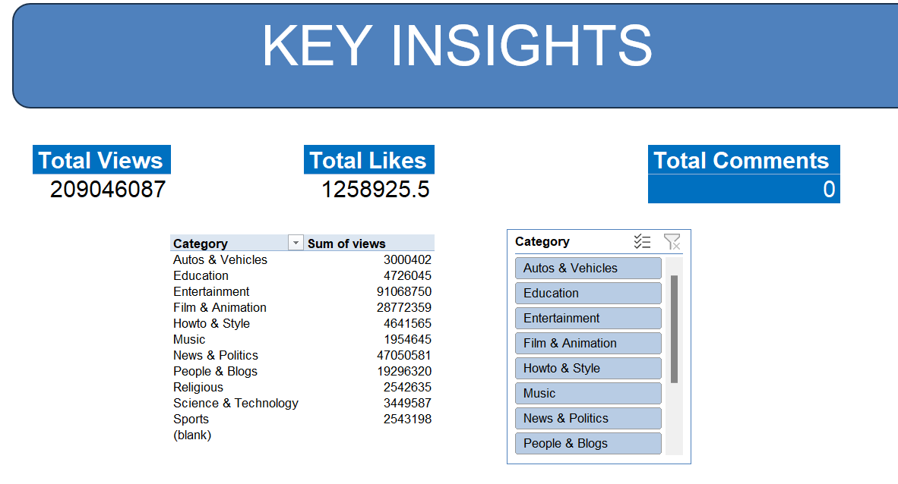
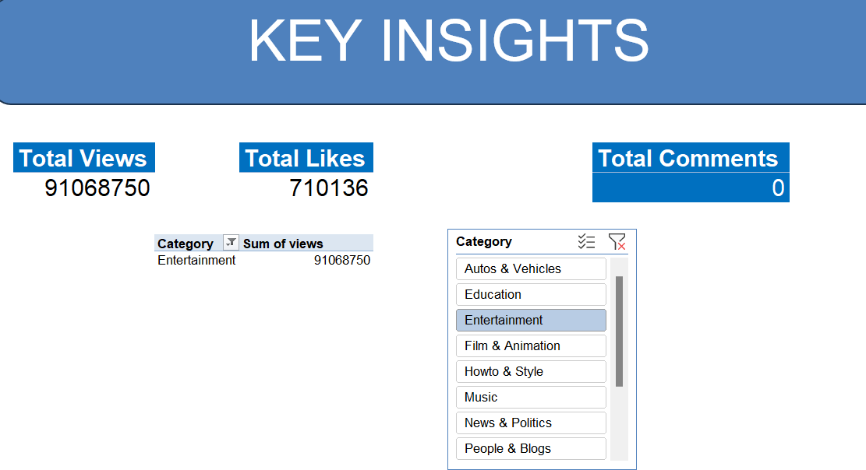
Q7
The task is to create a dashboard to look at the metrics of the whole videos…Like the views,total likes and other insights.
I Inserted a slicer to make it more interactive…Can see the total engagement by selecting the category in the slicer and connecting them to all

Slide 9
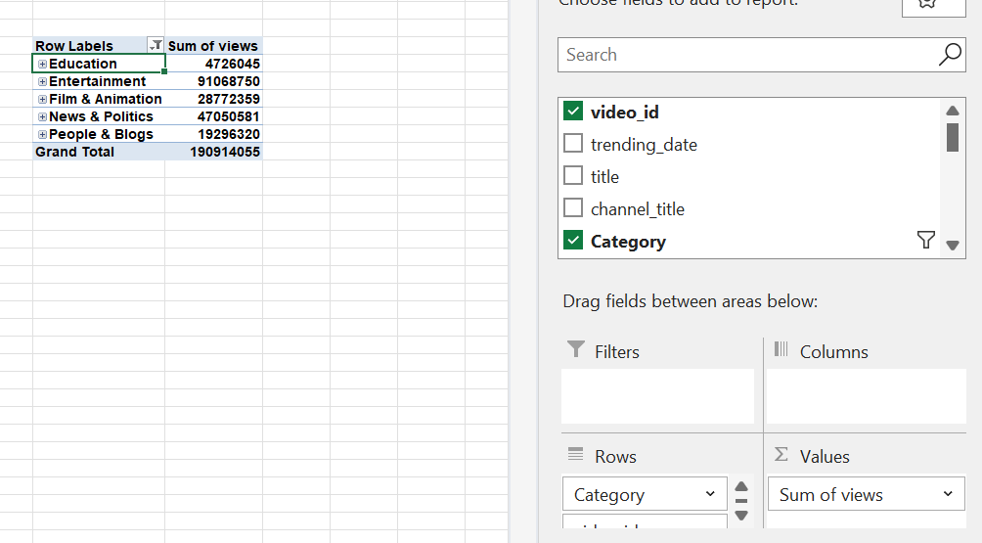
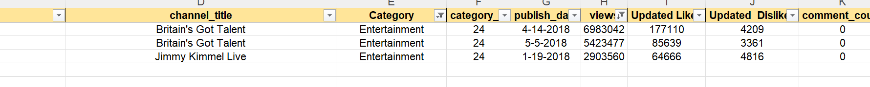
Q8
The task is to create a top3 list where the views are highest in a particular category
Here I took the entertainment category and the top 3 most viewed content in the category
Used The filters for filtering the top3 data
Also Can use the pivot table and find the categories performing well based on views,likes and then filtering the top 5 using the filter in the pivot table

Slide 10
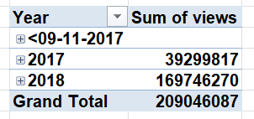
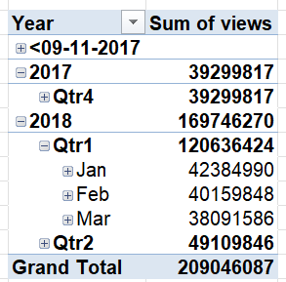
Q9
The task is to filter data based on the publish date and the number of views
I used a pivot table for the year and as we can see the number of views are higher for the year 2018. We can achieve this using the default filter by selecting the required dates or years.
In the year 2018 the 1st Quarter that is Jan,Feb,March did really well compared to the other Quarter

Slide 11
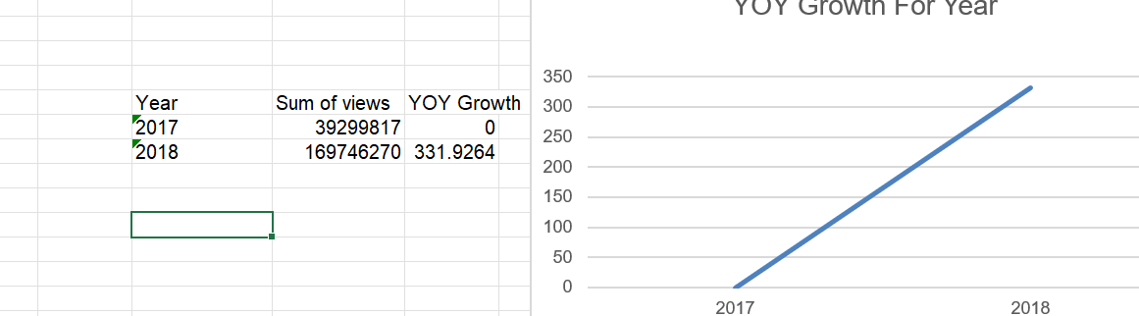
Q10
The YOY Growth can be calculated with the formula:=(this year views-previous years views)/previous year views)*100
The insight is that there is a significant increase of 331% in terms of the viewership growth

Slide 12
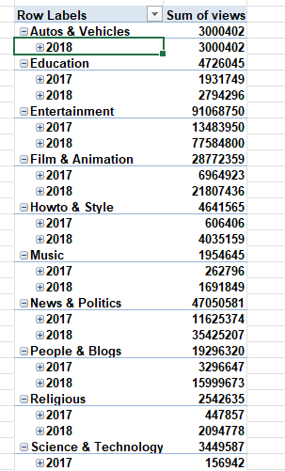
Q11
The task is to create cohorts based on the category and the publish date..
Here is the table where the categories are divided for each year and can see the total views for each category and each year

Slide 13
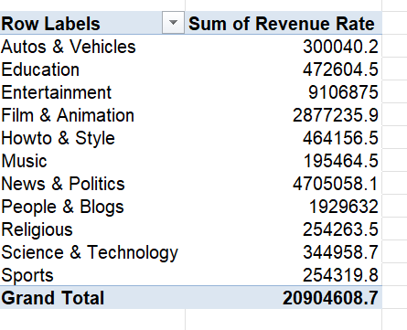
Q12
The task is to create an insight where the revenue for each category is clearly specified..
We can create a column name revenue and calculate the revenue using the revenue rate…
Then I created a pivot table for understanding the Revenues for each category
The Film and animation has earned the most revenue as the retention rate is high and also the engagement is high

Slide 14
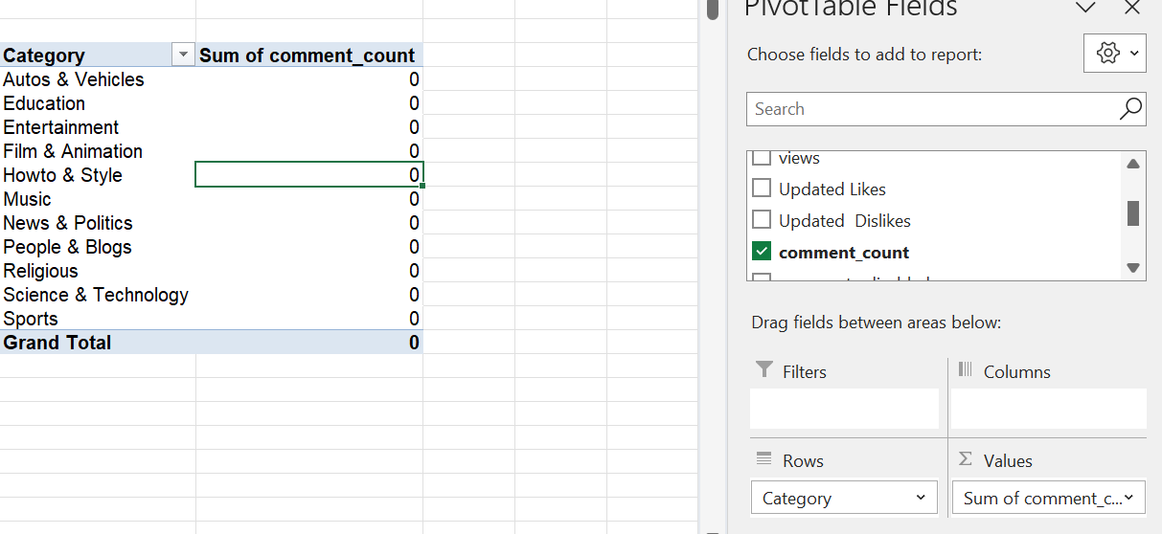
Q13
The Task is to analyze the count of comments for each category.. I used a pivot table to calculate the total count of comments and used the catrgories as rows..
As the data for comments is null as given the data is not shown properly

Slide 15
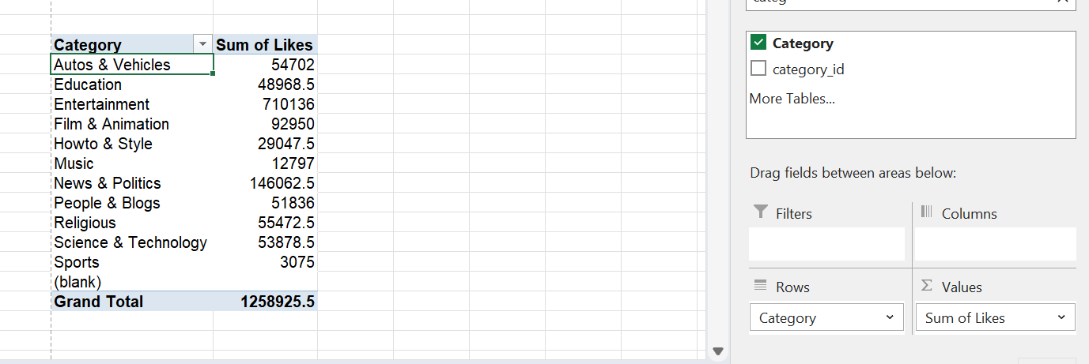
Q14
The task is to compare different metrics for each category.
Here I take the likes and the category and I use the pivot table..We can see the news and politics has the highest number of engagement

Slide 16
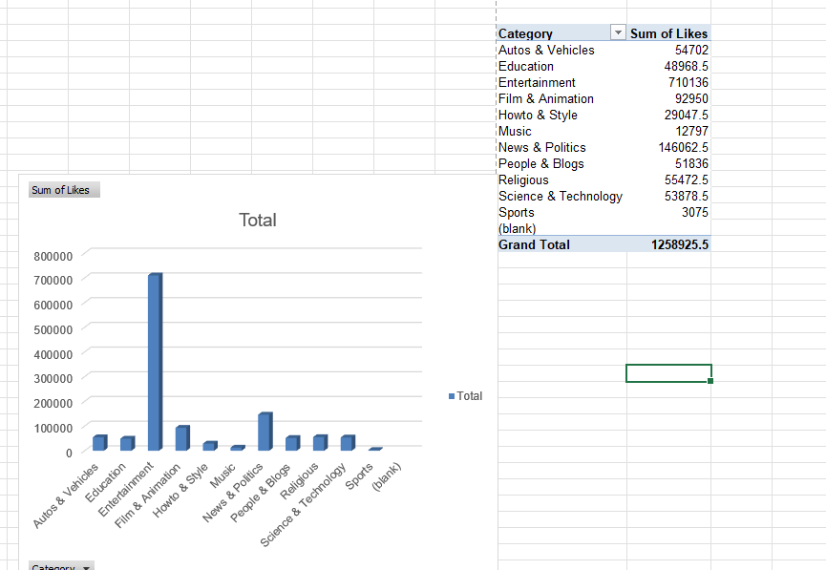
Q15
The task is to create a visualization based on the likes and also the engagement. Here I take the Likes for engagement And use the visualization for the likes

Slide 17
Q16-Q20
Year | Sum of Updated Likes
<09-11-2017
2017 | 162740
2018 | 1096185.5
Grand Total | 1258925.5

Slide 18
Q16-Q20
The Task From 16-20 is All about various engagement attributes…We have plot a year on year growth for The Likes in the year 2017 and 2018..
Then We did the engagements level for each state and plot it… We can also see the Total engagement in terms of likes …

